Slide 1
Structuri de date și algoritmi Grafuri – Acoperire și Capacitate
Lect. Dr. Ing. Cristian Chilipirea – cristian.chilipirea@mta.ro

Slide 3
Arbori minimi de acoperire
0
1
8
30
16
2
6
4
2
2
3
4
0
7
6
3
9
5
2
2
6
1
2
11
15
5
3
15
2
1
10
6
11
20
14
12
13
1
4

Slide 4
Arbori minimi de acoperire
0
1
8
30
16
2
6
4
2
2
3
4
0
7
6
3
9
5
2
2
6
1
2
11
15
5
3
15
2
1
10
6
11
20
14
12
13
1
4

Slide 5
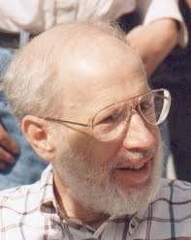
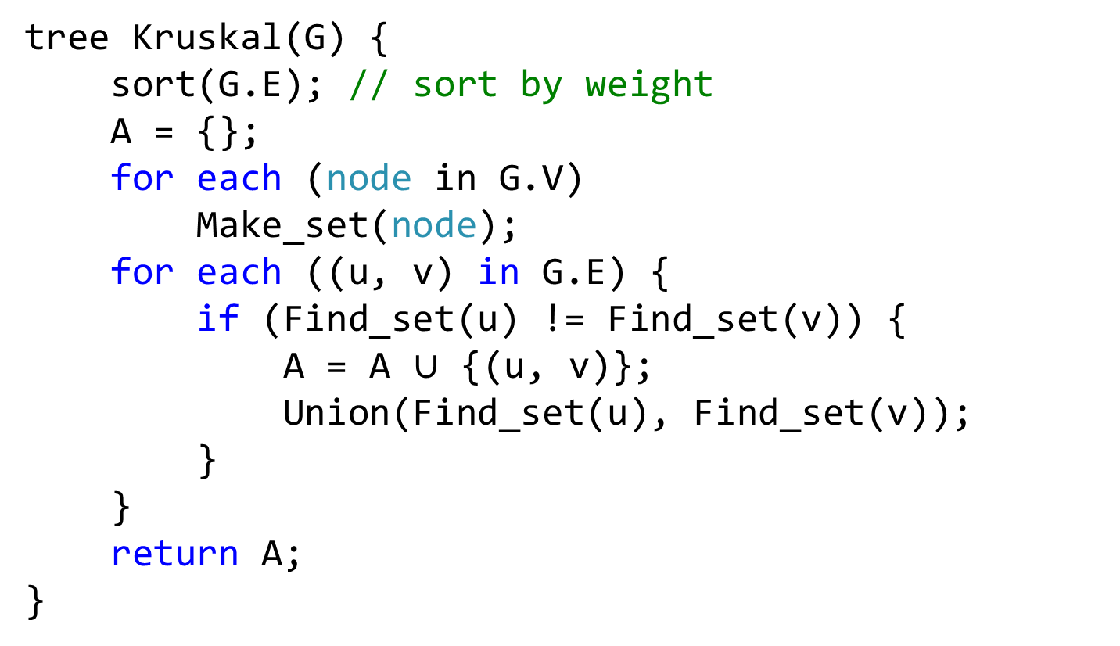
Algoritmul lui Kruskal (1956)
tree Kruskal(G) {
sort(G.E); // sort by weight
A = {};
for each (node in G.V)
Make_set(node);
for each ((u, v) in G.E) {
if (Find_set(u) != Find_set(v)) {
A = A $∪$ {(u, v)};
Union(Find_set(u), Find_set(v));
}
}
return A;
}

Slide 6
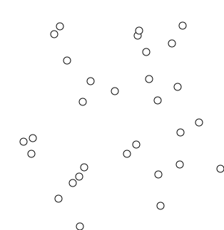
Algoritmul lui Kruskal
Kruscal animation

Slide 7
Algoritmul lui Kruskal
0
1
8
30
16
2
6
4
2
2
3
4
0
7
6
3
9
5
2
2
6
1
2
11
15
5
3
15
2
1
10
6
11
20
14
12
13
1
4

Slide 8
Algoritmul lui Kruskal
0
1
8
30
16
2
6
4
2
2
3
4
0
7
6
3
9
5
2
2
6
1
2
11
15
5
3
15
2
1
10
6
11
20
14
12
13
1
4

Slide 9
Algoritmul lui Kruskal
0
1
8
30
16
2
6
4
2
2
3
4
0
7
6
3
9
5
2
2
6
1
2
11
15
5
3
15
2
1
10
6
11
20
14
12
13
1
4

Slide 10
Algoritmul lui Kruskal
0
1
8
30
16
2
6
4
2
2
3
4
0
7
6
3
9
5
2
2
6
1
2
11
15
5
3
15
2
1
10
6
11
20
14
12
13
1
4

Slide 11
Algoritmul lui Kruskal
0
1
8
30
16
2
6
4
2
2
3
4
0
7
6
3
9
5
2
2
6
1
2
11
15
5
3
15
2
1
10
6
11
20
14
12
13
1
4

Slide 12
Algoritmul lui Kruskal
0
1
8
30
16
2
6
4
2
2
3
4
0
7
6
3
9
5
2
2
6
1
2
11
15
5
3
15
2
1
10
6
11
20
14
12
13
1
4

Slide 13
Algoritmul lui Kruskal
0
1
8
30
16
2
6
4
2
2
3
4
0
7
6
3
9
5
2
2
6
1
2
11
15
5
3
15
2
1
10
6
11
20
14
12
13
1
4

Slide 14
Algoritmul lui Kruskal
0
1
8
30
16
2
6
4
2
2
3
4
0
7
6
3
9
5
2
2
6
1
2
11
15
5
3
15
2
1
10
6
11
20
14
12
13
1
4

Slide 15
Algoritmul lui Kruskal
0
1
8
30
16
2
6
4
2
2
3
4
0
7
6
3
9
5
2
2
6
1
2
11
15
5
3
15
2
1
10
6
11
20
14
12
13
1
4

Slide 16
Algoritmul lui Kruskal
0
1
8
30
16
2
6
4
2
2
3
4
0
7
6
3
9
5
2
2
6
1
2
11
15
5
3
15
2
1
10
6
11
20
14
12
13
1
4

Slide 17
Algoritmul lui Kruskal
0
1
8
30
16
2
6
4
2
2
3
4
0
7
6
3
9
5
2
2
6
1
2
11
15
5
3
15
2
1
10
6
11
20
14
12
13
1
4

Slide 18
Algoritmul lui Kruskal
0
1
8
30
16
2
6
4
2
2
3
4
0
7
6
3
9
5
2
2
6
1
2
11
15
5
3
15
2
1
10
6
11
20
14
12
13
1
4

Slide 19
Algoritmul lui Kruskal
0
1
8
30
16
2
6
4
2
2
3
4
0
7
6
3
9
5
2
2
6
1
2
11
15
5
3
15
2
1
10
6
11
20
14
12
13
1
4

Slide 20
Algoritmul lui Kruskal
0
1
8
30
16
2
6
4
2
2
3
4
0
7
6
3
9
5
2
2
6
1
2
11
15
5
3
15
2
1
10
6
11
20
14
12
13
1
4

Slide 21
Algoritmul lui Kruskal
0
1
8
30
16
2
6
4
2
2
3
4
0
7
6
3
9
5
2
2
6
1
2
11
15
5
3
15
2
1
10
6
11
20
14
12
13
1
4

Slide 22
Algoritmul lui Kruskal
0
1
8
30
16
2
6
4
2
2
3
4
0
7
6
3
9
5
2
2
6
1
2
11
15
5
3
15
2
1
10
6
11
20
14
12
13
1
4

Slide 23
Algoritmul lui Kruskal
0
1
8
30
16
2
6
4
2
2
3
4
0
7
6
3
9
5
2
2
6
1
2
11
15
5
3
15
2
1
10
6
11
20
14
12
13
1
4

Slide 24
Algoritmul lui Kruskal
0
1
8
30
16
2
6
4
2
2
3
4
0
7
6
3
9
5
2
2
6
1
2
11
15
5
3
15
2
1
10
6
11
20
14
12
13
1
4

Slide 25
Algoritmul lui Kruskal
0
1
8
30
16
2
6
4
2
2
3
4
0
7
6
3
9
5
2
2
6
1
2
11
15
5
3
15
2
1
10
6
11
20
14
12
13
1
4

Slide 26
Algoritmul lui Kruskal
0
1
8
30
16
2
6
4
2
2
3
4
0
7
6
3
9
5
2
2
6
1
2
11
15
5
3
15
2
1
10
6
11
20
14
12
13
1
4

Slide 27
Algoritmul lui Kruskal
0
1
8
30
16
2
6
4
2
2
3
4
0
7
6
3
9
5
2
2
6
1
2
11
15
5
3
15
2
1
10
6
11
20
14
12
13
1
4

Slide 28
Algoritmul lui Kruskal
0
1
8
30
16
2
6
4
2
2
3
4
0
7
6
3
9
5
2
2
6
1
2
11
15
5
3
15
2
1
10
6
11
20
14
12
13
1
4

Slide 29
Algoritmul lui Kruskal
0
1
8
30
16
2
6
4
2
2
3
4
0
7
6
3
9
5
2
2
6
1
2
11
15
5
3
15
2
1
10
6
11
20
14
12
13
1
4

Slide 30
Algoritmul lui Kruskal
0
1
8
30
16
2
6
4
2
2
3
4
0
7
6
3
9
5
2
2
6
1
2
11
15
5
3
15
2
1
10
6
11
20
14
12
13
1
4

Slide 31
Algoritmul lui Kruskal
0
1
8
30
16
2
6
4
2
2
3
4
0
7
6
3
9
5
2
2
6
1
2
11
15
5
3
15
2
1
10
6
11
20
14
12
13
1
4

Slide 32
Complexitate?
tree Kruskal(G) {
sort(G.E); // sort by weight
A = {};
for each (node in G.V)
Make_set(node);
for each ((u, v) in G.E) {
if (Find_set(u) != Find_set(v)) {
A = A $∪$ {(u, v)};
Union(Find_set(u), Find_set(v));
}
}
return A;
}

Slide 33
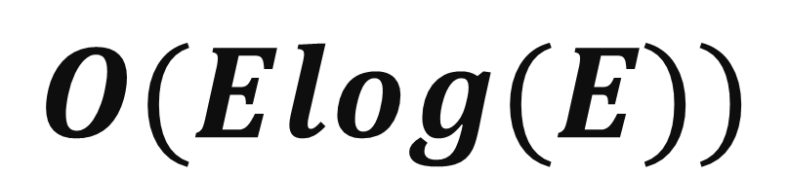
Complexitate?
$$O(Elog(E))$$

Slide 34
Flux maxim

Slide 35
Graf capacitate
În general valoarea de pe muchie reprezintă o distanță.
O distanță mai mare face muchia mai greu de parcurs.
Valoarea muchiei poate reprezenta o capacitate.
Similar apei/curentului, cu cât capacitatea e mai mare cu atât e mai ușor de parcurs.
Șoselele au și distanță și capacitate (număr benzi/viteză max)
1
2
2
1
2
0/2

Slide 36
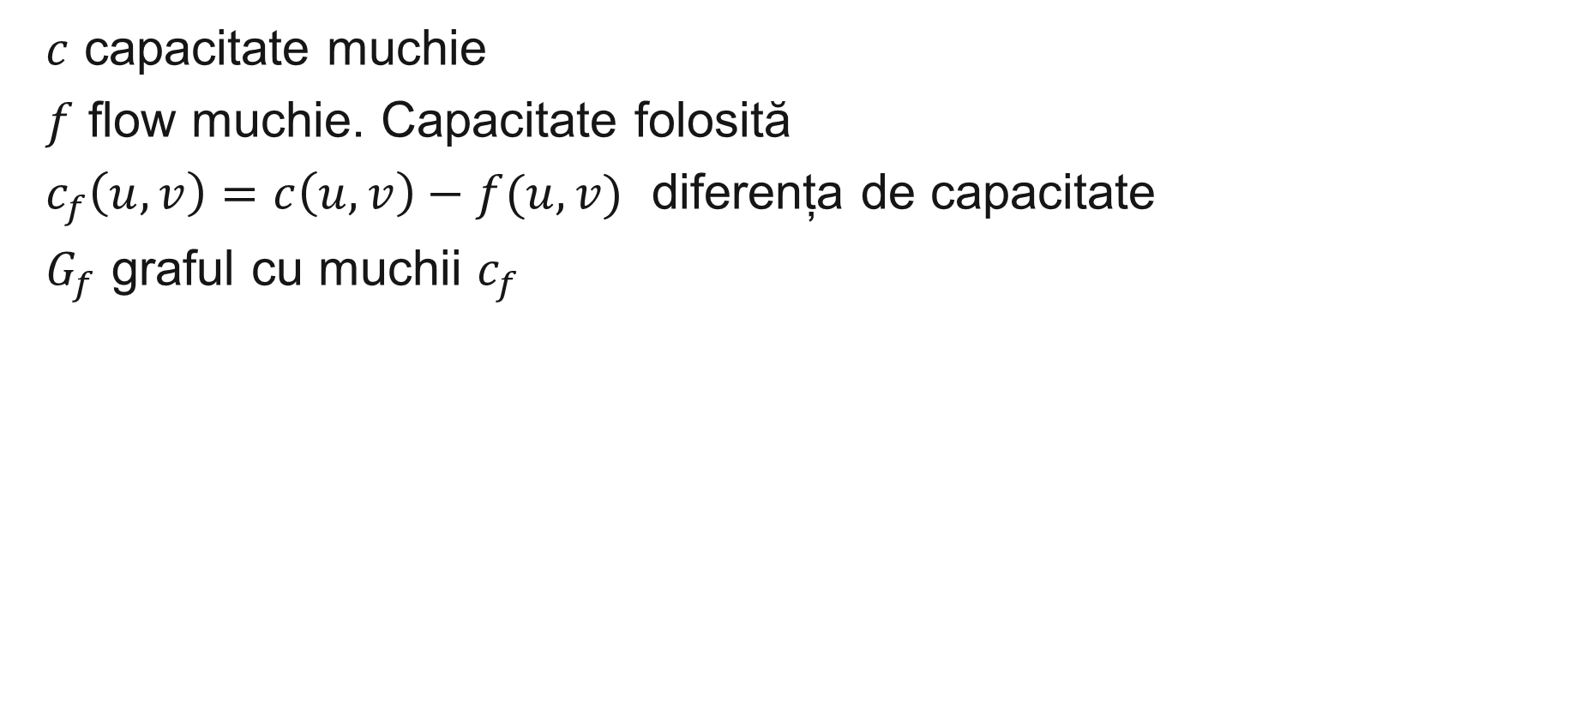
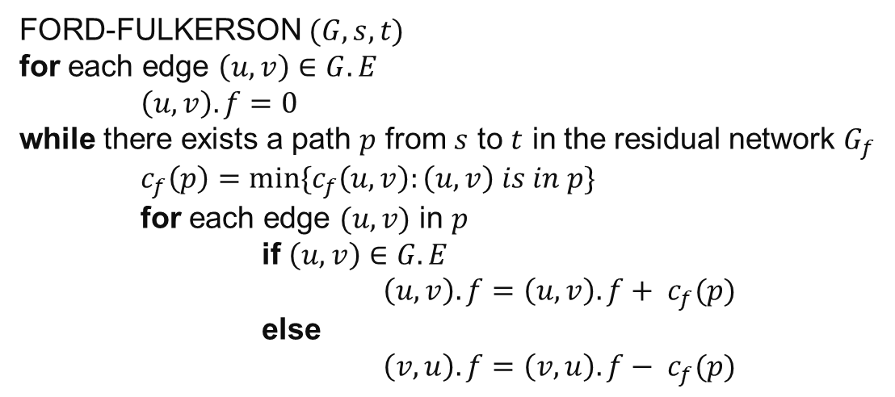
Flux maxim Algoritmul Ford-Fulkerson
$c$ capacitate muchie
$f$ flow muchie. Capacitate folosită
$c_{f}\left(u,v\right)=c\left(u,v\right)−f(u,v)$ diferența de capacitate
$G_{f}$ graful cu muchii $c_{f}$
FORD-FULKERSON $(G, s, t)$
for each edge $\left(u,v\right)∈G.E$
$\left(u, v\right).f=0$
while there exists a path $p$ from $s$ to $t$ in the residual network $G_{f}$
$c_{f}\left(p\right)=min⁡\{c_{f}\left(u,v\right):\left(u,v\right) is in p\}$
for each edge $(u,v)$ in $p$
if $\left(u,v\right)∈G.E$
$\left(u,v\right).f=\left(u,v\right).f+ c_{f}(p)$
else
$\left(v,u\right).f=\left(v,u\right).f− c_{f}(p)$

Slide 37
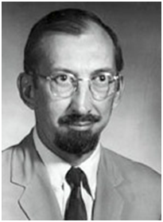
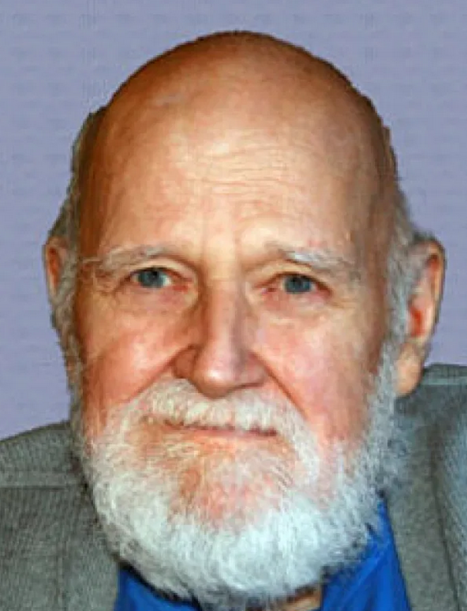
Flux maxim Algoritmul Ford-Fulkerson (1956)
$c$ capacitate muchie
$f$ flow muchie. Capacitate folosită
$c_{f}\left(u,v\right)=c\left(u,v\right)−f(u,v)$ diferența de capacitate
$G_{f}$ graful cu muchii $c_{f}$

Slide 38
Algoritmul Ford-Fulkerson
0/12
1
3
0/16
0/20
s
0/4
0/9
0/7
t
0/4
0/13
2
4
0/14

Slide 39
Algoritmul Ford-Fulkerson
0/12
1
3
0/16
0/20
s
0/4
0/9
0/7
t
0/4
0/13
2
4
0/14

Slide 40
Algoritmul Ford-Fulkerson
4/12
1
3
4/16
0/20
s
0/4
4/9
0/7
t
4/4
0/13
2
4
4/14

Slide 41
Algoritmul Ford-Fulkerson
4/12
1
3
4/16
0/20
s
0/4
4/9
0/7
t
4/4
0/13
2
4
4/14

Slide 42
Algoritmul Ford-Fulkerson
4/12
1
3
4/16
0/20
s
0/4
4/9
0/7
t
4/4
0/13
2
4
4/14

Slide 43
Algoritmul Ford-Fulkerson
8/12
1
3
4/16
4/20
s
4/4
4/9
0/7
t
4/4
4/13
2
4
4/14

Slide 44
Algoritmul Ford-Fulkerson
8/12
1
3
4/16
4/20
s
4/4
4/9
0/7
t
4/4
4/13
2
4
4/14

Slide 45
Algoritmul Ford-Fulkerson
8/12
1
3
4/16
4/20
s
4/4
4/9
0/7
t
4/4
4/13
2
4
4/14

Slide 46
Algoritmul Ford-Fulkerson
8/12
1
3
8/16
8/20
s
0/4
0/9
0/7
t
4/4
4/13
2
4
4/14

Slide 47
Algoritmul Ford-Fulkerson
8/12
1
3
8/16
8/20
s
0/4
0/9
0/7
t
4/4
4/13
2
4
4/14

Slide 48
Algoritmul Ford-Fulkerson
8/12
1
3
8/16
8/20
s
0/4
0/9
0/7
t
4/4
4/13
2
4
4/14

Slide 49
Algoritmul Ford-Fulkerson
12/12
1
3
12/16
12/20
s
0/4
0/9
0/7
t
4/4
4/13
2
4
4/14

Slide 50
Algoritmul Ford-Fulkerson
12/12
1
3
12/16
12/20
s
0/4
0/9
0/7
t
4/4
4/13
2
4
4/14

Slide 51
Algoritmul Ford-Fulkerson
12/12
1
3
12/16
12/20
s
0/4
0/9
0/7
t
4/4
4/13
2
4
4/14

Slide 52
Algoritmul Ford-Fulkerson
12/12
1
3
12/16
12/20
s
0/4
0/9
0/7
t
4/4
4/13
2
4
4/14

Slide 53
Algoritmul Ford-Fulkerson
12/12
1
3
12/16
12/20
s
0/4
0/9
0/7
t
4/4
4/13
2
4
4/14

Slide 54
Algoritmul Ford-Fulkerson
12/12
1
3
12/16
12/20
s
0/4
0/9
0/7
t
4/4
4/13
2
4
4/14

Slide 55
Algoritmul Ford-Fulkerson
12/12
1
3
12/16
19/20
s
0/4
0/9
7/7
t
11/13
4/4
2
4
11/14

Slide 56
Algoritmul Ford-Fulkerson
12/12
1
3
12/16
19/20
s
0/4
0/9
7/7
t
11/13
4/4
2
4
11/14

Slide 57
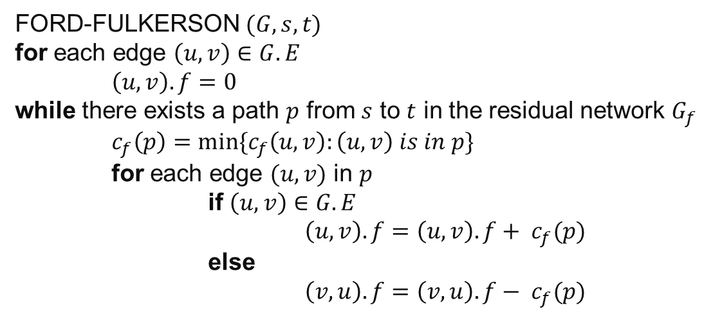
Complexitate?
FORD-FULKERSON $(G, s, t)$
for each edge $\left(u,v\right)∈G.E$
$\left(u, v\right).f=0$
while there exists a path $p$ from $s$ to $t$ in the residual network $G_{f}$
$c_{f}\left(p\right)=min⁡\{c_{f}\left(u,v\right):\left(u,v\right) is in p\}$
for each edge $(u,v)$ in $p$
if $\left(u,v\right)∈G.E$
$\left(u,v\right).f=\left(u,v\right).f+ c_{f}(p)$
else
$\left(v,u\right).f=\left(v,u\right).f− c_{f}(p)$
1
1,000,000
1,000,000
s
1
t
1,000,000
1,000,000
2

Slide 58

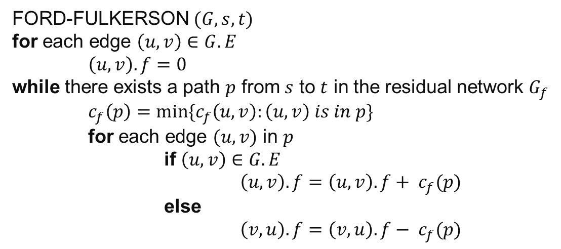

Complexitate?
Dacă alegem $p$ random
$$O(E\left|f^{∗}\right|)$$
FORD-FULKERSON $(G, s, t)$
for each edge $\left(u,v\right)∈G.E$
$\left(u, v\right).f=0$
while there exists a path $p$ from $s$ to $t$ in the residual network $G_{f}$
$c_{f}\left(p\right)=min⁡\{c_{f}\left(u,v\right):\left(u,v\right) is in p\}$
for each edge $(u,v)$ in $p$
if $\left(u,v\right)∈G.E$
$\left(u,v\right).f=\left(u,v\right).f+ c_{f}(p)$
else
$\left(v,u\right).f=\left(v,u\right).f− c_{f}(p)$
1
1,000,000
1,000,000
s
1
t
1,000,000
1,000,000
2

Slide 59
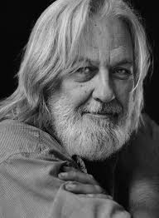
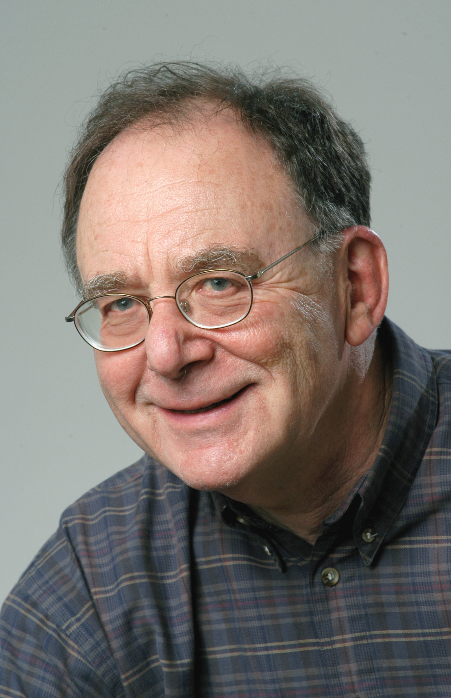
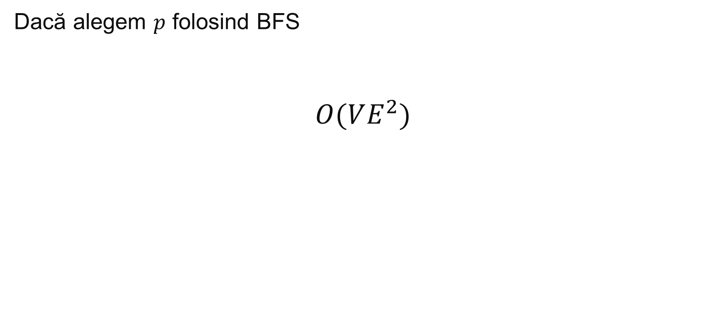
Algoritmul Edmonds–Karp (1972)
Dacă alegem $p$ folosind BFS
$$O(VE^{2})$$

Slide 60
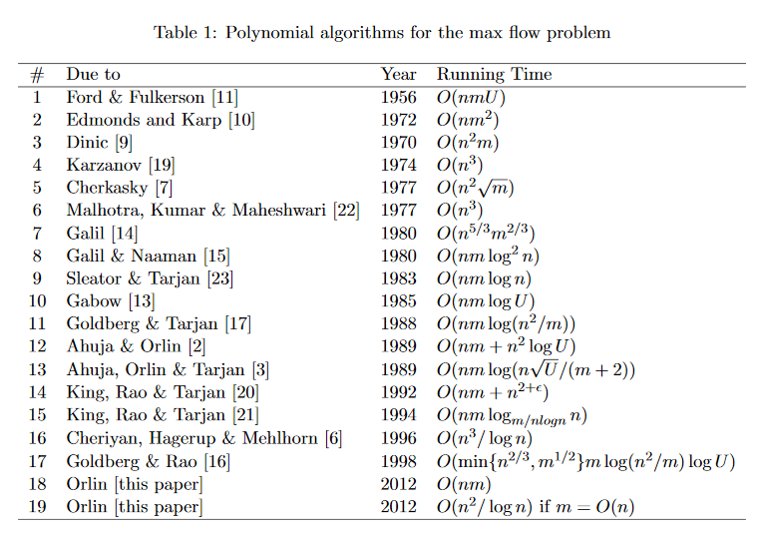
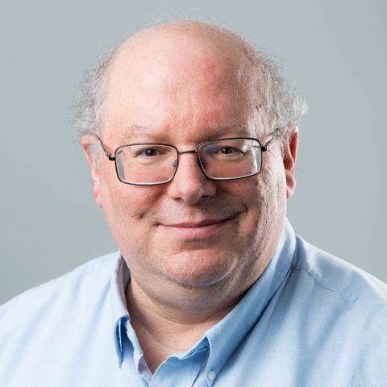
Există și algoritmi cu complexitate mai bună
“Max flows in O(nm) time, or better” – James Orlin

Slide 61
Alte considerente grafuri
Se pot schimba în timp.
LineGraph – Pentru un graf non-direcțional muchiile devin noduri și nodurile muchii.

Slide 62
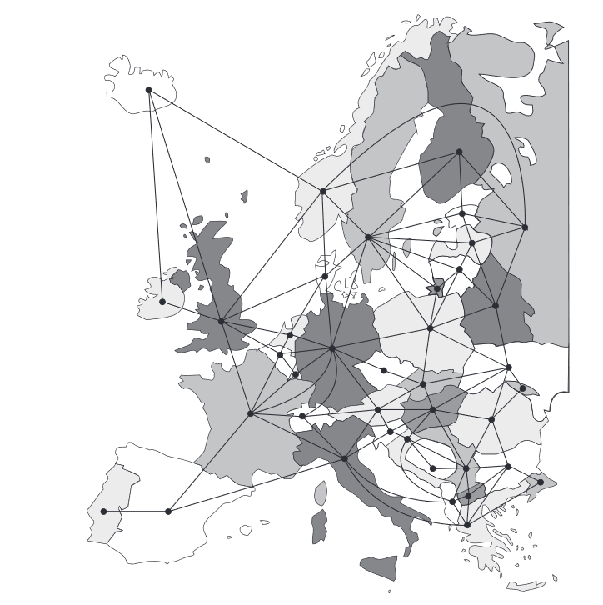
Use case grafuri – Granițe
Notes:
Maarten van Steen book Graph Theory and Complex networks

Slide 63
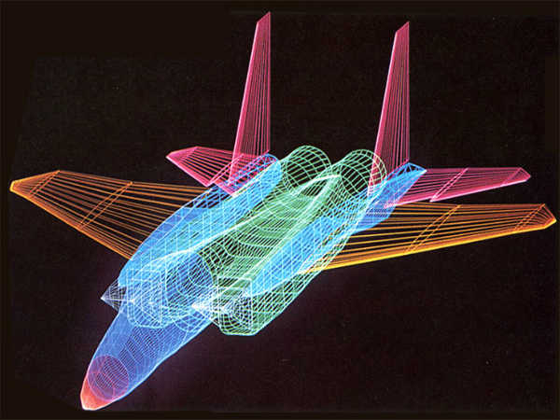
Use case grafuri – Grafică calculator
Notes:
https://www.careerindia.com/img/2017/05/computergraphics-05-1493980157.jpg

Slide 64
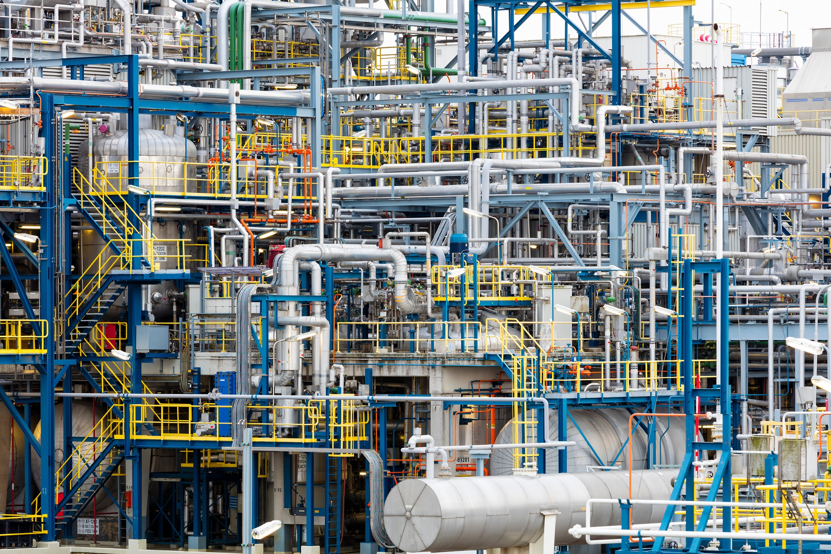
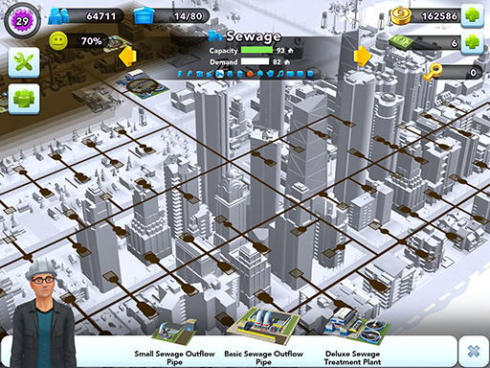
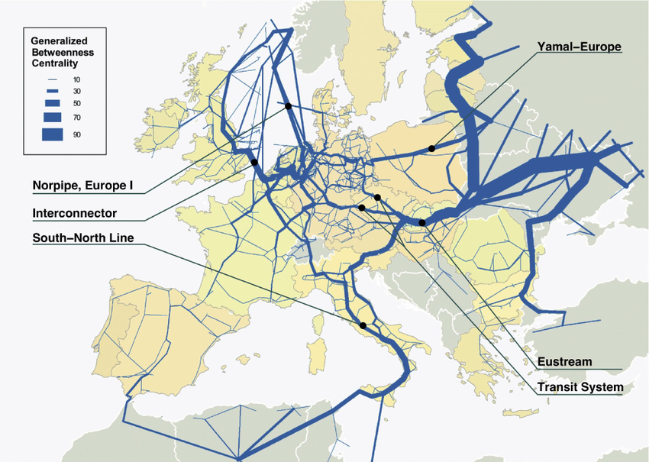
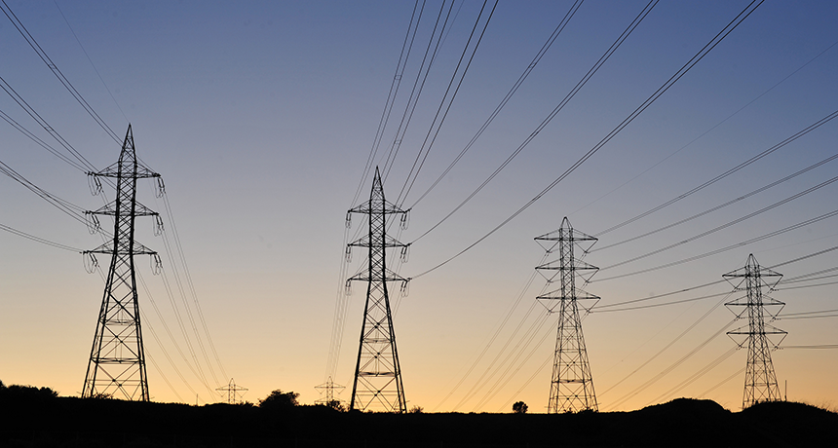
Use caser grafuri – utilități
Notes:
https://www.steeljrv.com/what-is-a-piping-system.html/pipe-network
https://www.sciencenewsforstudents.org/wp-content/uploads/2019/11/860_explainer_electric_grid.png
https://simcity-buildit.zendesk.com/hc/en-us/article_attachments/200484461/Sewage.jpg
https://www.researchgate.net/figure/Colour-online-Trans-European-natural-gas-network-Link-thickness-is-proportional-to-the_fig4_26720900

Slide 65
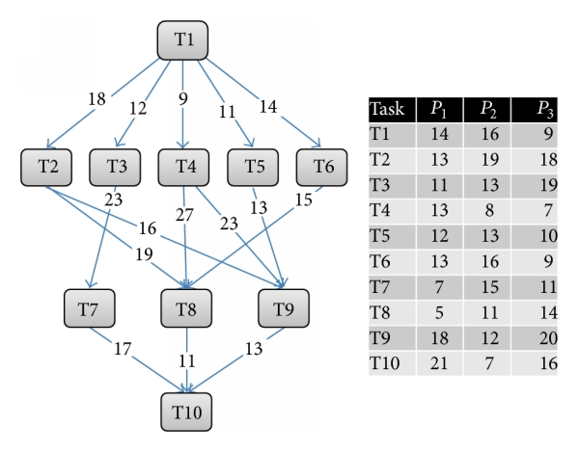
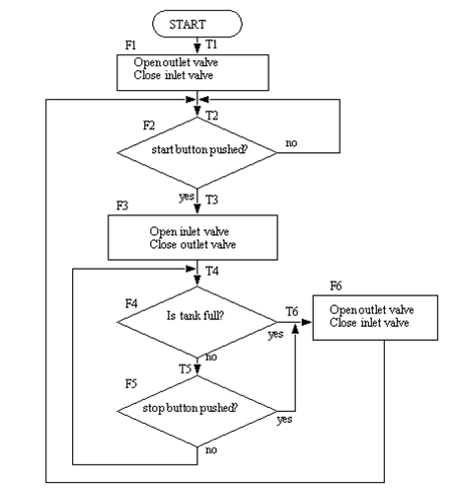
Use case grafuri – Code
Notes:
https://eternalsunshineoftheismind.files.wordpress.com/2013/02/picture2.png?w=584
https://www.researchgate.net/publication/298796513/figure/fig5/AS:349282696744977@1460286892795/Example-of-DAG-task-model-and-computation-cost-matrix.png

Slide 66
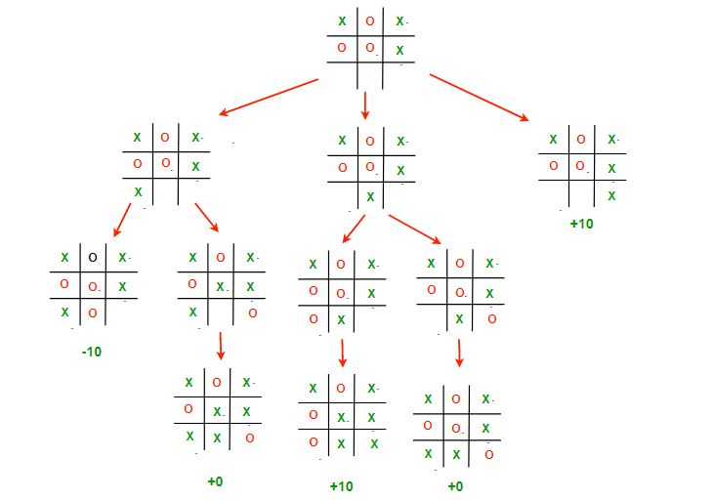
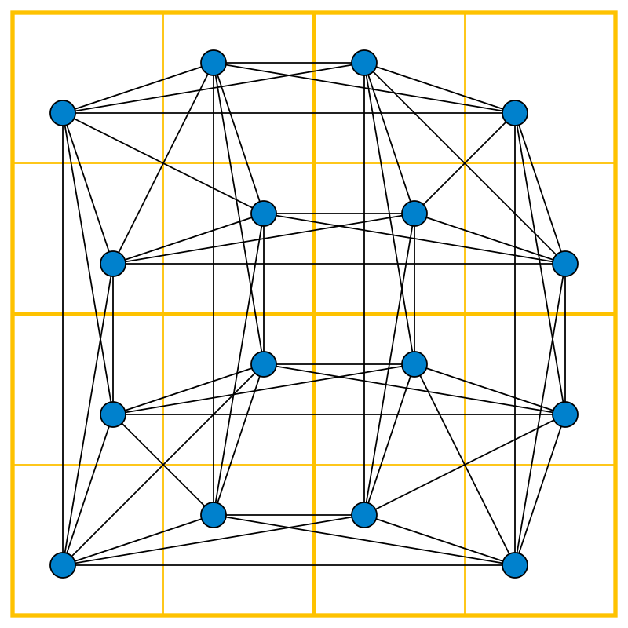
Use case grafuri – Reprezentare Jocuri
Notes:
https://upload.wikimedia.org/wikipedia/commons/thumb/5/5c/4x4_Sudoku_graph.svg/1200px-4x4_Sudoku_graph.svg.png
https://media.geeksforgeeks.org/wp-content/uploads/TIC_TAC.jpg

Slide 67
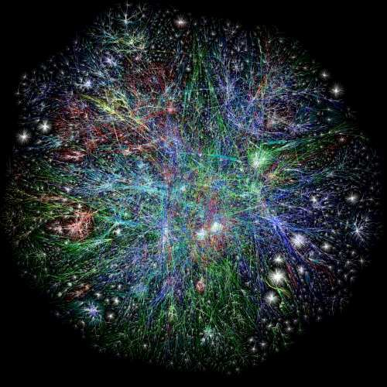
Use case grafuri - Internet
Notes:
https://www.researchgate.net/profile/Quan_Nguyen43/publication/325794369/figure/fig2/AS:639787606220801@1529548660141/Example-of-large-and-complex-networks-Visualization-of-the-Internet-graph-by-the-Opte.png

Slide 68
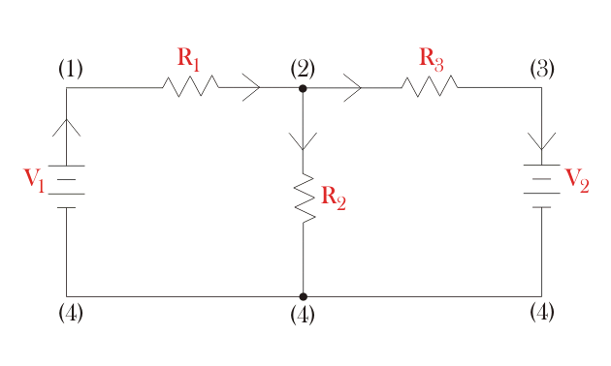
Use case grafuri – Circuite electrice
Notes:
https://www.electrical4u.com/images/january16/1452676005.gif

Slide 69
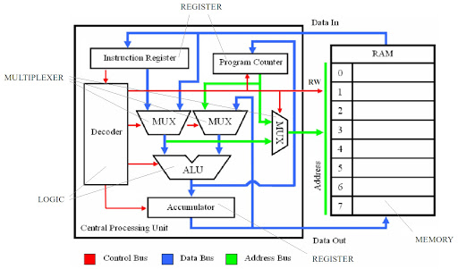
Use case grafuri – Circuite logice
Notes:
https://lh3.googleusercontent.com/proxy/JTpuEXCGIXYIdIarFcIABiJ8N03pO3vH-OV4yoD_UjzEtF8wIcZV0EGv-yZimla2m8bSxymW5q2cS0nN7RFMJaCIt8gs-itW98b0okdZ9l32Gzd0

Slide 70
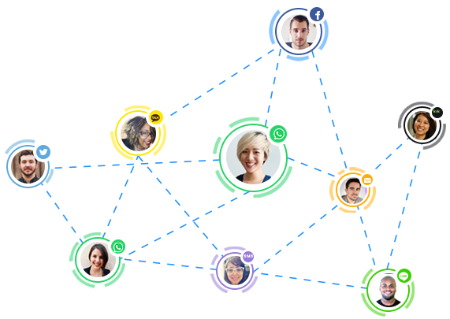
Use case grafuri – Grafuri sociale
Notes:
https://docs.getsocial.im/images/social-graph/social-graph-hero.png

Slide 71
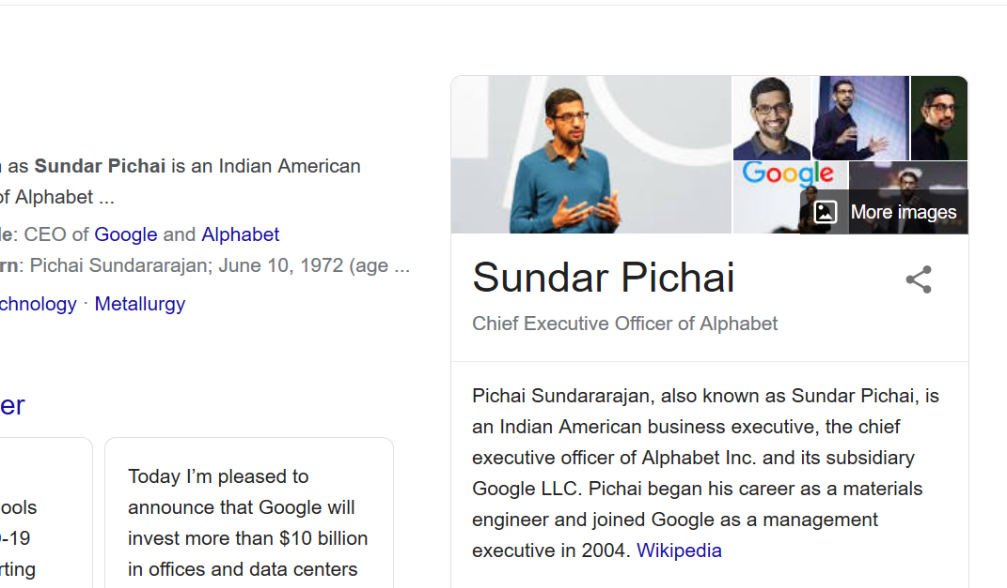
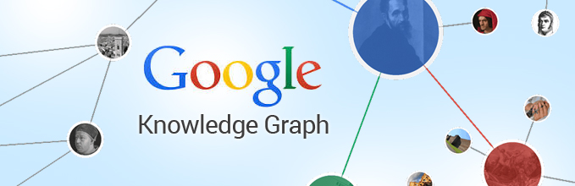
Use case-uri – Knowledge graph
Notes:
https://cdn.business2community.com/wp-content/uploads/2015/04/Google-Knowledge-Graph.jpg

Slide 72
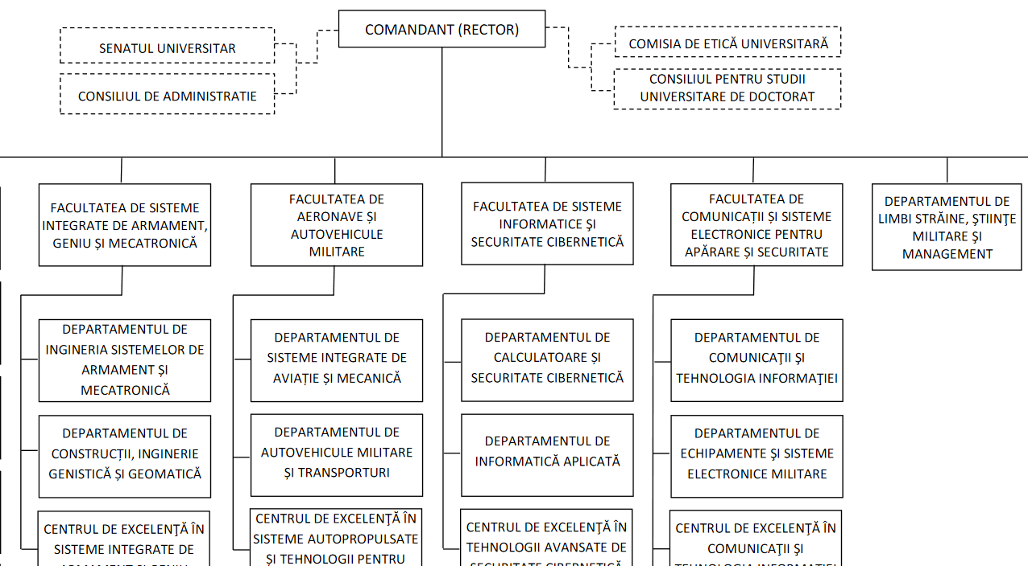
Use case-uri – Organigrame
Notes:
https://mta.ro/wp-content/uploads/2019/02/20181022_ORGANIGRAMA-pt.-WEB-ATM.pdf

